Slide 1
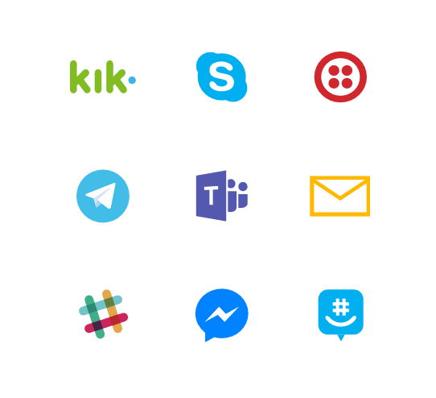
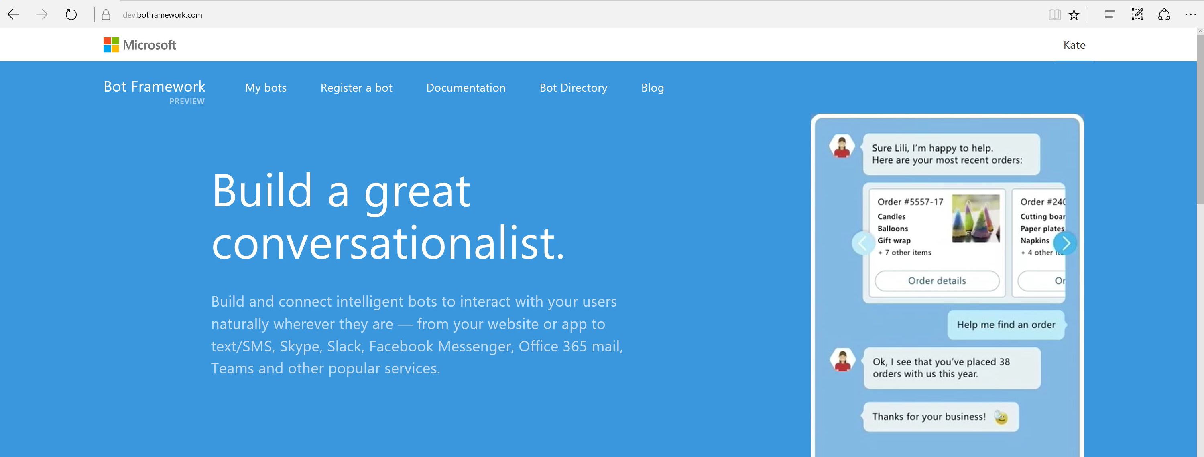
Bot Framework

Slide 2
Bot Framework
Day 1
Presentation
Hands On Workshop
Whiteboard
Day 2
Whiteboard
Bot Development
Day 3
Review
Bot Development
Wrap-up

Slide 3
Today’s Agenda
What is a bot
NLP – Natural Language Processing and LUIS
Channels
Connecter and Messages
Dialogs and Conversations
Other things to think about
Hands On Lab

Slide 4
Once in a Decade Opportunity
High demand from companies of all sizes
Opportunity for more natural experiences
Users spending more time on messaging apps
Simpler deployment/update model than apps
App ecosystem overly crowded
Everybody wants to automate something

Slide 5
What makes a bot great?
It is not how “smart” they are
It is not how much natural language they offer
It is not whether they use voice or not
It’s whether it solves the user’s needs in the quickest/easiest way compared to any other option
It’s all about user experience... Just like an app, or a website

Slide 6
The best bots make you type less, not more

Slide 7
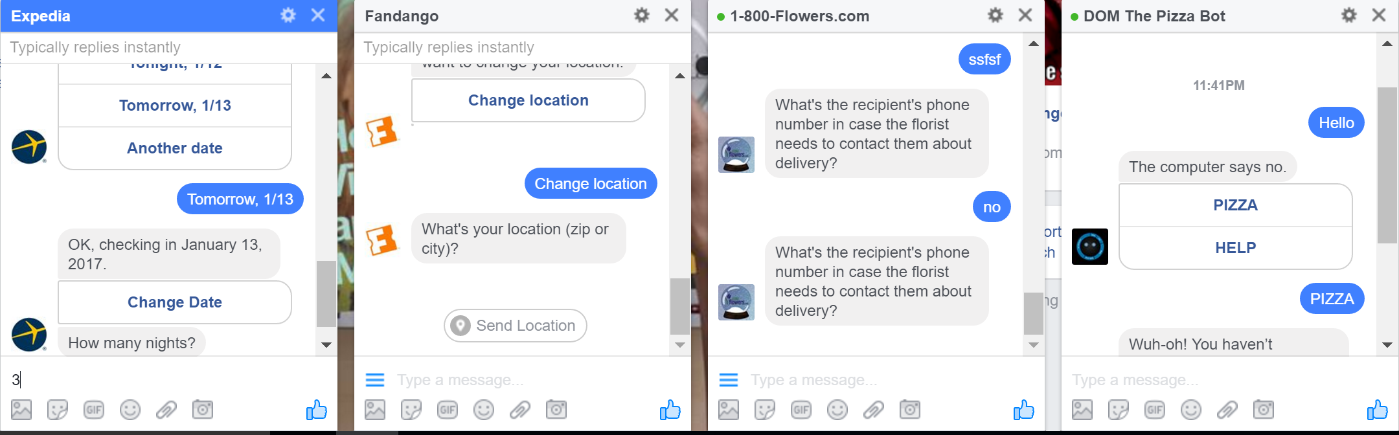
Bots of today (show examples)
https://www.botpages.com/
Notes:
But they were not very useful, just a simple experiment.

Slide 8
Why Bots are like text based Adventure Games

Slide 9
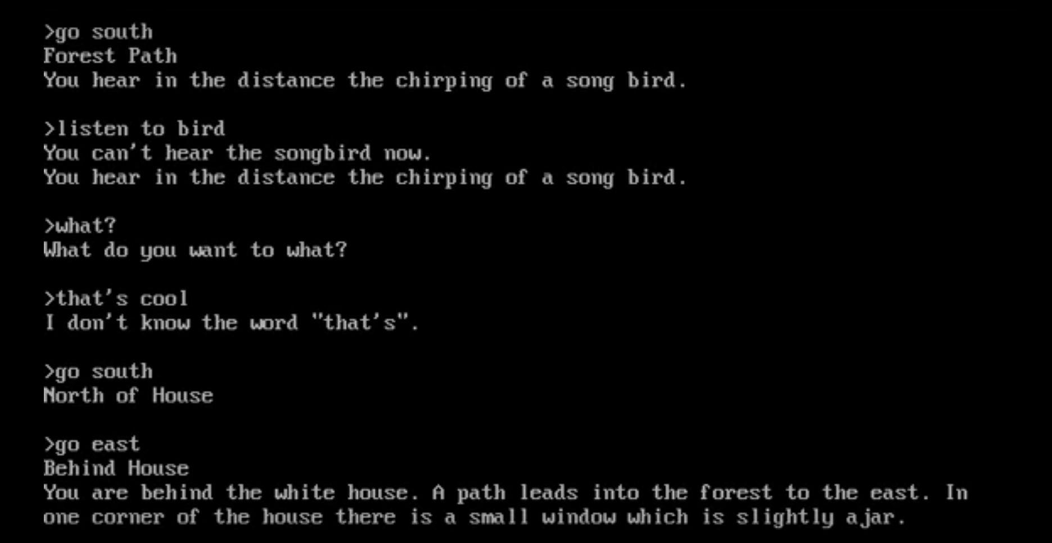

Slide 10
NLP To the Rescue

Slide 11
Why is NLP so hard?

Slide 12
“I saw a man on a hill with a telescope.”
Simple statement?
There’s a man on a hill, and I’m watching him with my telescope.
There’s a man on a hill, who I’m seeing, and he has a telescope.
There’s a man, and he’s on a hill that also has a telescope on it.
I’m on a hill, and I saw a man using a telescope.
Notes:
http://blog.algorithmia.com/introduction-natural-language-processing-nlp/
https://www.youtube.com/watch?v=8S3qHHUKqYk
Tons of stuff here : http://blog.algorithmia.com/introduction-natural-language-processing-nlp/
Human generated language.
spam detection
Millennial speak
On fleek
Bae
Dabbing
Yolo
Throwing Shade

Slide 13
Think about a bot used to answer customers questions about laptops and accessories.
Has my order number 15489 been shipped yet?
How fast is the Surface 3?
Do you sell Acer Laptops and drives?
What kind of a display is on Surface 4
Notes:
http://blog.algorithmia.com/introduction-natural-language-processing-nlp/
https://www.youtube.com/watch?v=8S3qHHUKqYk
Tons of stuff here : http://blog.algorithmia.com/introduction-natural-language-processing-nlp/
Human generated language.
spam detection
Millennial speak
On fleek
Bae
Dabbing
Yolo
Throwing Shade

Slide 14
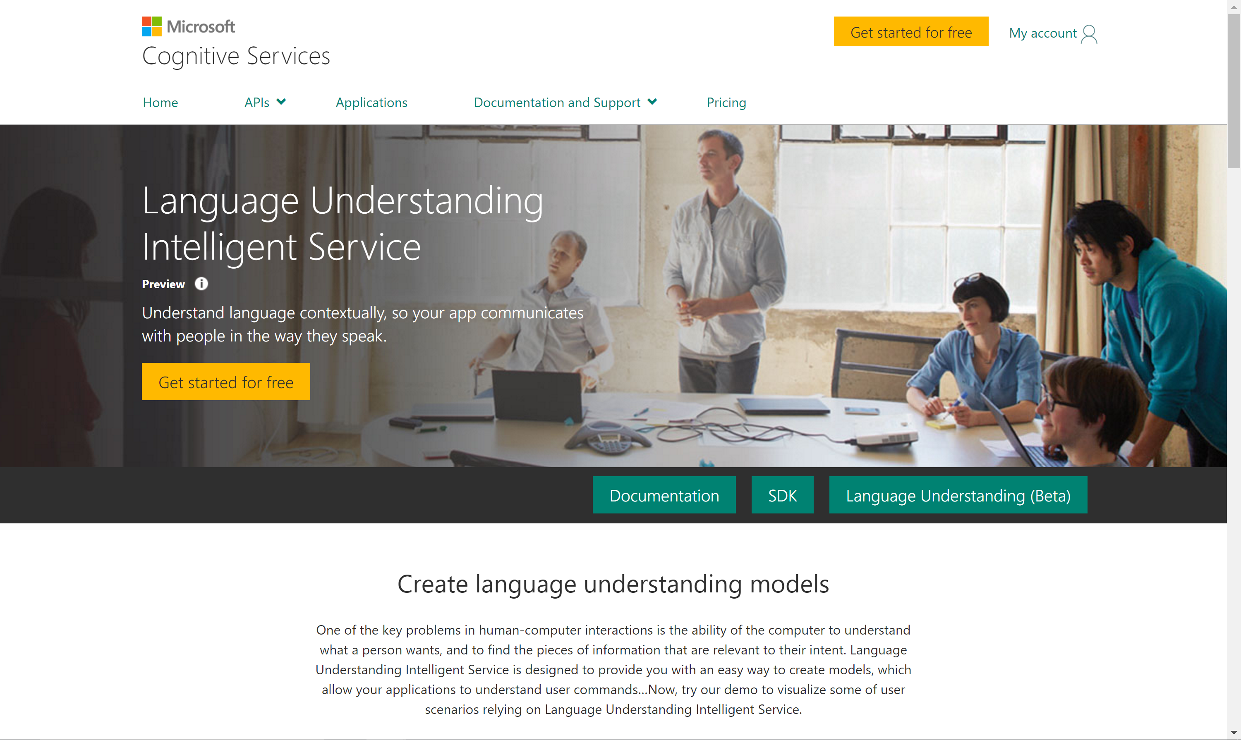

Slide 15
Determine Intent
Define Entities

Slide 16
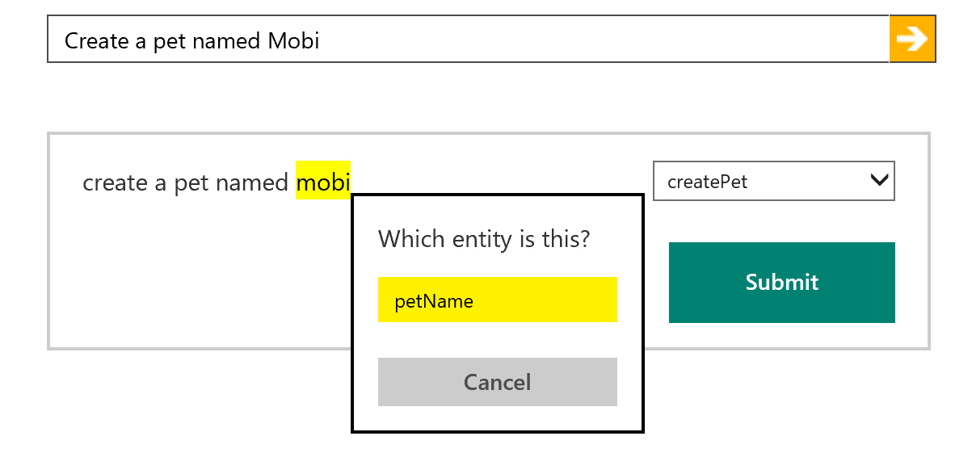
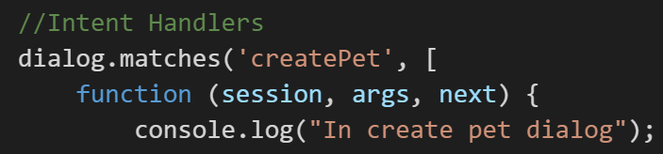
How LUIS.ai works
LUIS.ai
Language Understanding Intelligence Service
Identify entities and intents of messages
Train through GUI or programmatically
Built in LUIS intent handling in bot framework

Slide 17



Intent Recognizers
What they said
What they meant
Intent
Recognizer
Implements IIntent Interface

Slide 18
New bot developers tend to abuse NLP
A bot with a single dialog using 100 LUIS intents is a bad design:
One question
100 LUIS intents, * 100 different utterances per intent = 10000 different things users may say (plus the other 90000 possibilities you didn’t predict)
100 different things your bot can do
Users will only guess 3 or so
So you just wasted 97% of your code
Hello user! How can I help you?

Slide 19
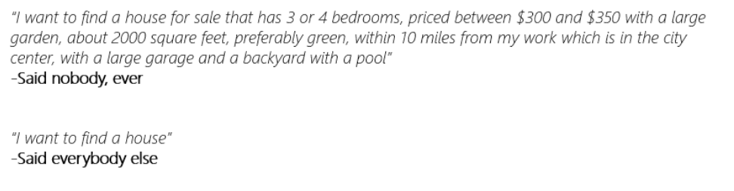
Users never say things the way you expect
As you model your NLP, make sure you’re being realistic

Slide 20
New bot developers tend to abuse NLP
So instead:
Hello user! How can I help you?
What events are you interested in?
What music would you like? (by the way, next time you could just type “I’m looking for a song named xyz” and I will know what to do)
Events
Music
Stages
Comedy
Amenities
Film
Laser Dome
Spectacles
Theater
Guide the user
Save time
Help the user discover what your bot can do

Slide 21
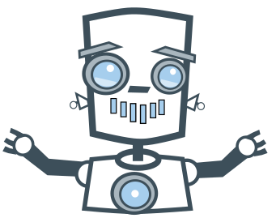
Directed or Non-Directed

Slide 22
Non -Directed
Directed

Slide 23
Non -Directed
Directed

Slide 24
How do I sign up?
How can you help me
Is there a warrantee?
What is a reserve price?
How long does the battery last?
I'm looking for cameras
Show me some shoes.
General Questions
Product Search
Product Details

Slide 25
The Bot Framework

Slide 26
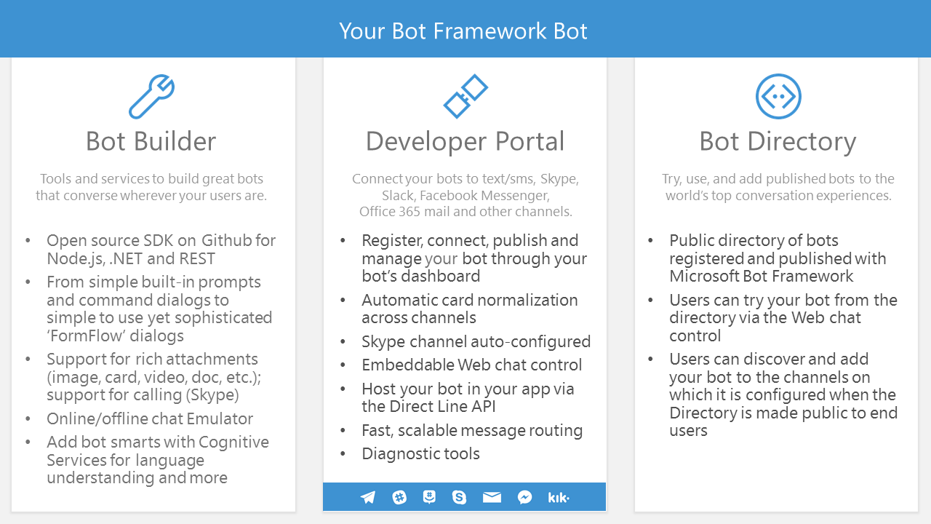

Slide 27
An x-ray of a typical bot
Conversation Canvas/Channels
Your code goes here
Web Chat
Bot Connector Service
Email
Message input <> output
State Management
Facebook
GroupMe
Your bot code
API, SDK calls
Kik
Skype
Bot Builder SDK
Slack
+ Microsoft Cognitive Services
Telegram
Other services, APIs,
Databases, Azure Machine Learning, Azure Search, etc…
Natural Language
Translation
Vision/Face
Emotion
Twilio (SMS)
…
Direct Line…
Speech
Entity Extraction
Search
Knowledge API
…
…
…

Slide 28











Bot Communication
User
Channel
Bot

Slide 29
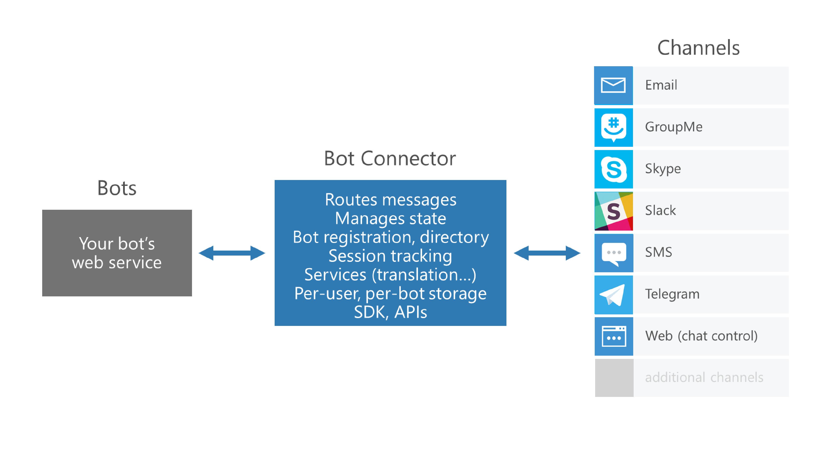

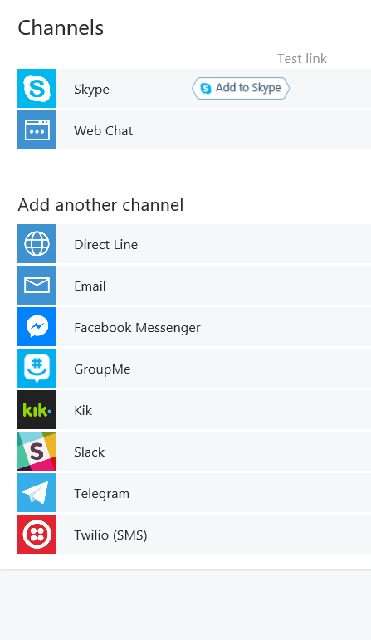

Slide 30

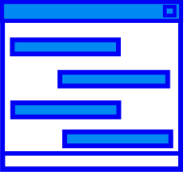
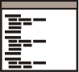
Connector Service
Connector Service
Bot
Channel
Activity JSON
Channel JSON

Slide 31
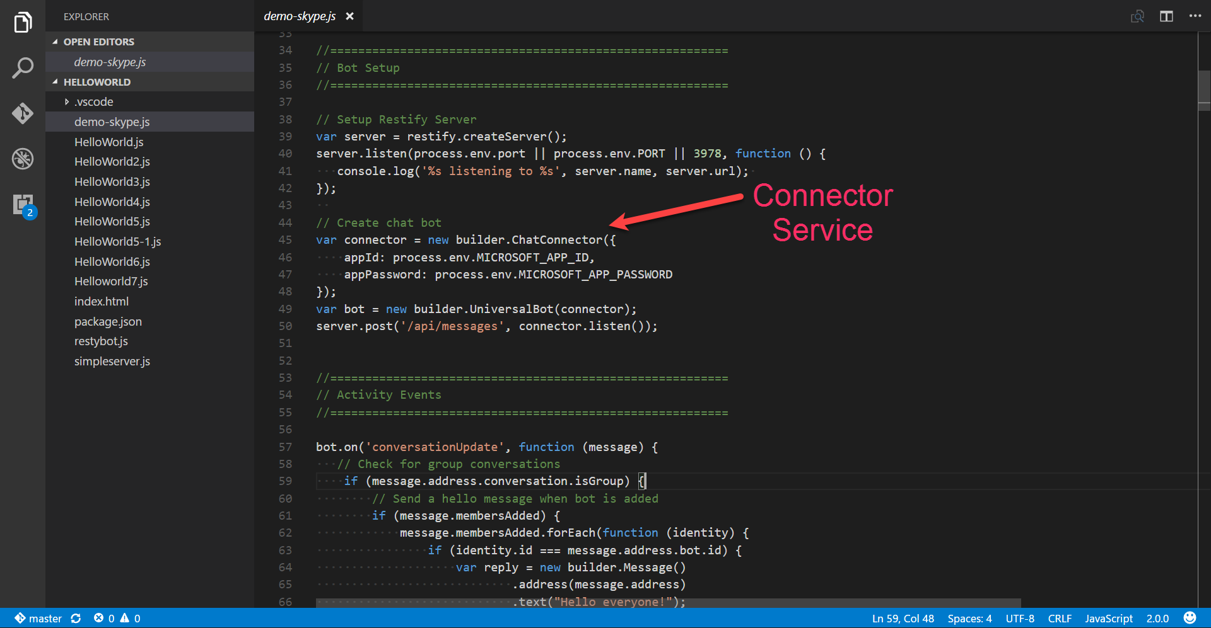

Slide 32

Dialogs
User
Bot
Hi
Hi I'm Dinner Bot how can I help you today?
I would like to reserve a table.
Great, lets get started.

Slide 33
Dialogs = Routing
Hi
How can I help you
I want to reserve a table
Do we know the user?
No
Yes
GetUserInfoDialog
ReservationDialog

Slide 34
Dialog Chain
Conversation
Introduction Dialog
User Info Dialog
Reservation Dialog
C# Chaining or Context.Call
node beginDialog/endDialog or waterfall

Slide 35
Persisting Data
userData
stores information globally for the user across all conversations.
conversationData
stores information globally for a single conversation. This data is visible to everyone within the conversation so care should be used to what’s stored there. It’s disabled by default and needs to be enabled using the bots persistConversationData setting.
privateConversationData
stores information globally for a single conversation but its private data for the current user. This data spans all dialogs so it’s useful for storing temporary state that you want cleaned up when the conversation ends.
dialogData
persists information for a single dialog instance. This is essential for storing temporary information in between the steps of a waterfall.

Slide 36
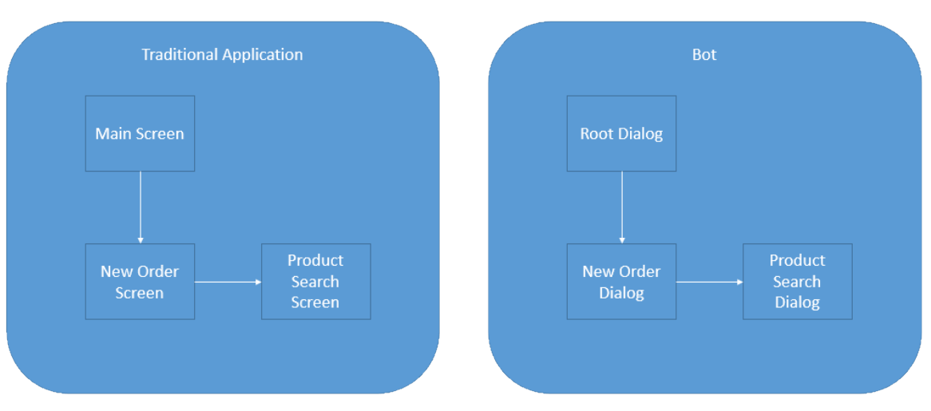
Dialogs are for bots like screens are for apps
They separate concerns and organize flows, exactly the same way:

Slide 37
Invoking a Dialog
var server = restify.createServer();
server.listen(process.env.port || process.env.PORT || 3978, function () { });
var connector = new builder.ChatConnector({
appId: process.env.MICROSOFT_APP_ID,
appPassword: process.env.MICROSOFT_APP_PASSWORD
});
var bot = new builder.UniversalBot(connector);
server.post('/api/messages', connector.listen());
// Root dialog
bot.dialog('/', ...

Slide 38
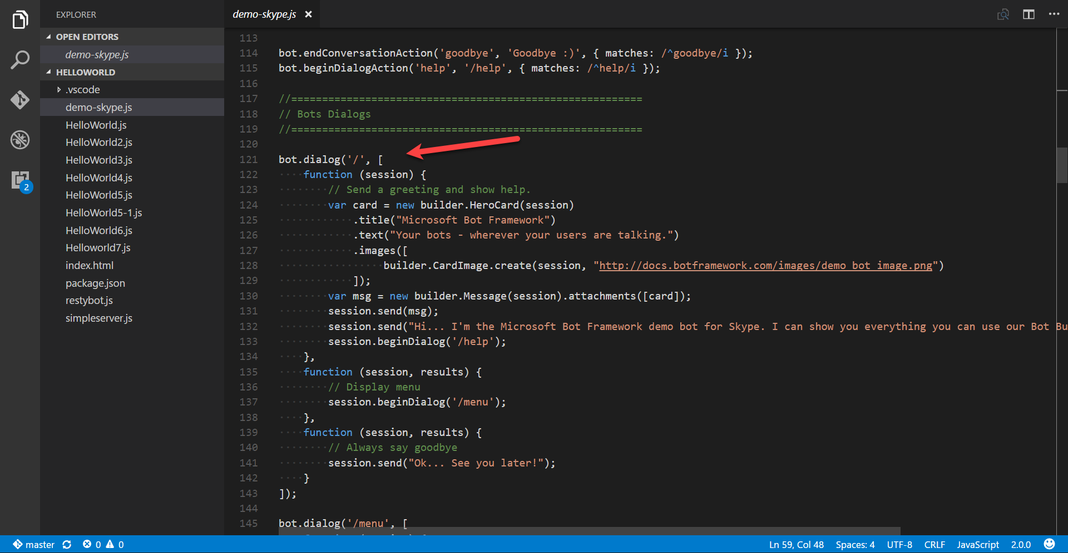

Slide 39
Dialogs are serialized into stacks
This is how we know how to navigate “back”
Users won’t necessarily think that way
Root Dialog
Dialog 1
Dialog 2
…

Slide 40
Redirecting to a Dialog
bot.dialog('/', new builder.IntentDialog()
//Did the user type 'order'?
.matchesAny([/order/i], [
function (session) {
//Let's invoke then the new order dialog
session.beginDialog('/newOrder');
},
function (session, result) {
//This will get us whatever the new order dialog decided to return to us
var resultFromNewOrder = result.response;
session.send('New order dialog just told me this: %s', resultFromNewOrder');
//We are now done with the root dialog
session.endDialog();
}
])

Slide 41
Redirecting to a Dialog
bot.dialog('/startCampaign', [
function (session, args, next) {
builder.Prompts.confirm(session, 'Do you already have a gift in mind?');
},
function (session, args, next ) {
if (args.response) {
builder.Prompts.choice(session, 'Is your gift from the website or elsewhere?', ['I found my gift the site', 'I found my gift from an external site', 'I didn\'t find my gift yet']);
} else {
session.send('That\'s okay, we can help you pick out the perfect gift! ');
return session.replaceDialog('/productSearch');
}

Slide 42
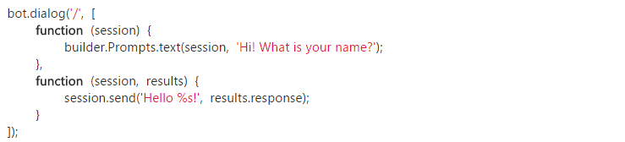
Waterfall
Exactly what it sounds like.

Slide 43
Simple Waterfall
var builder = require('botbuilder');
var connector = new builder.ConsoleConnector().listen();
var bot = new builder.UniversalBot(connector);
bot.dialog('/', [
function (session) {
builder.Prompts.text(session, 'Hi! What is your name?');
},
function (session, results) {
session.send('Hello %s!', results.response);
}
]);
Our root dialog '/'
Uses a text prompt to collect name
and put in session.
we use the result of the prompt
to echo back to user (notice that it
is an array of functions in the
dialog)

Slide 44
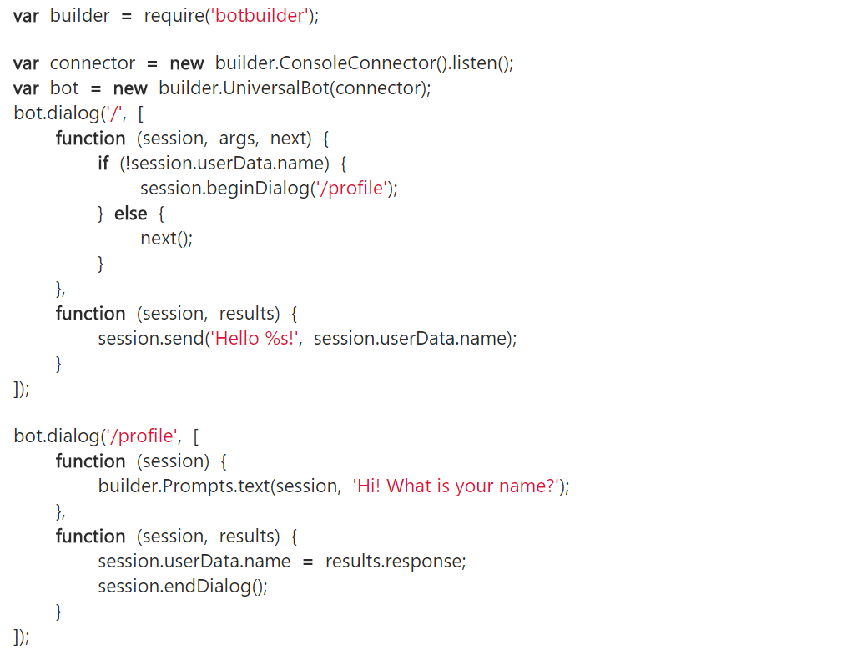
First Run
Nothing new here
Our root dialog '/'
Checks session.userdata
if no username sends to
our '/profile' dialog using
beginDialog()
We use a text prompt to collect
name
once data is collected we call
endDialog()

Slide 45
First Run
Our code flow returns here and
proceeds to the next function
We then address user by name
This whole dialog is not used
next time through

Slide 46
NEW First Run
var builder = require('botbuilder');
var connector = new builder.ConsoleConnector().listen();
var bot = new builder.UniversalBot(connector);
bot.dialog('/', function (session) {
session.send("%s, I heard: %s", session.userData.name, session.message.text);
session.send("Say something else...");
});
// Install First Run middleware and dialog
bot.use(builder.Middleware.firstRun({ version: 1.0, dialogId: '*:/firstRun' }));
bot.dialog('/firstRun', [
function (session) {
builder.Prompts.text(session, "Hello... What's your name?");
},
function (session, results) {
// We'll save the users name and send them an initial greeting. All
// future messages from the user will be routed to the root dialog.
session.userData.name = results.response;
session.endDialog("Hi %s, say something to me and I'll say it back to you.", session.userData.name);
}
]);
First Run Versioning

Slide 47
What else?

Slide 48
Prompt types
Prompts.text()
Prompts.confirm()
Prompts.number()
Prompts.time()
Prompts.choice()
Prompts.attachment()

Slide 49
Search can do wonders for bots
QnAMaker.ai:
Super low friction way of creating a Q&A bot
Built in web and document crawler: Parses data and builds the QnA easily
Not great for too many records
Not great for deep level customization of the experience
Azure Search:
Can work with millions of records like a breeze
Works with different document formats and data sources
Takes more effort to prepare/code/fine-tune

Slide 50
Others
First Run Conversation
First Run User
Proactive
Hand-off
Recommendation API
Directline
Middleware
Events

Slide 51
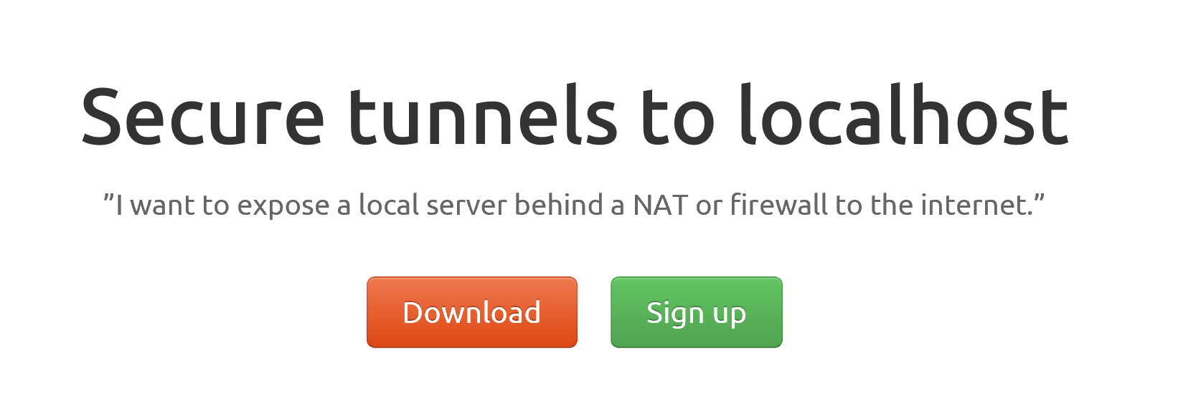
ngrok

Slide 52
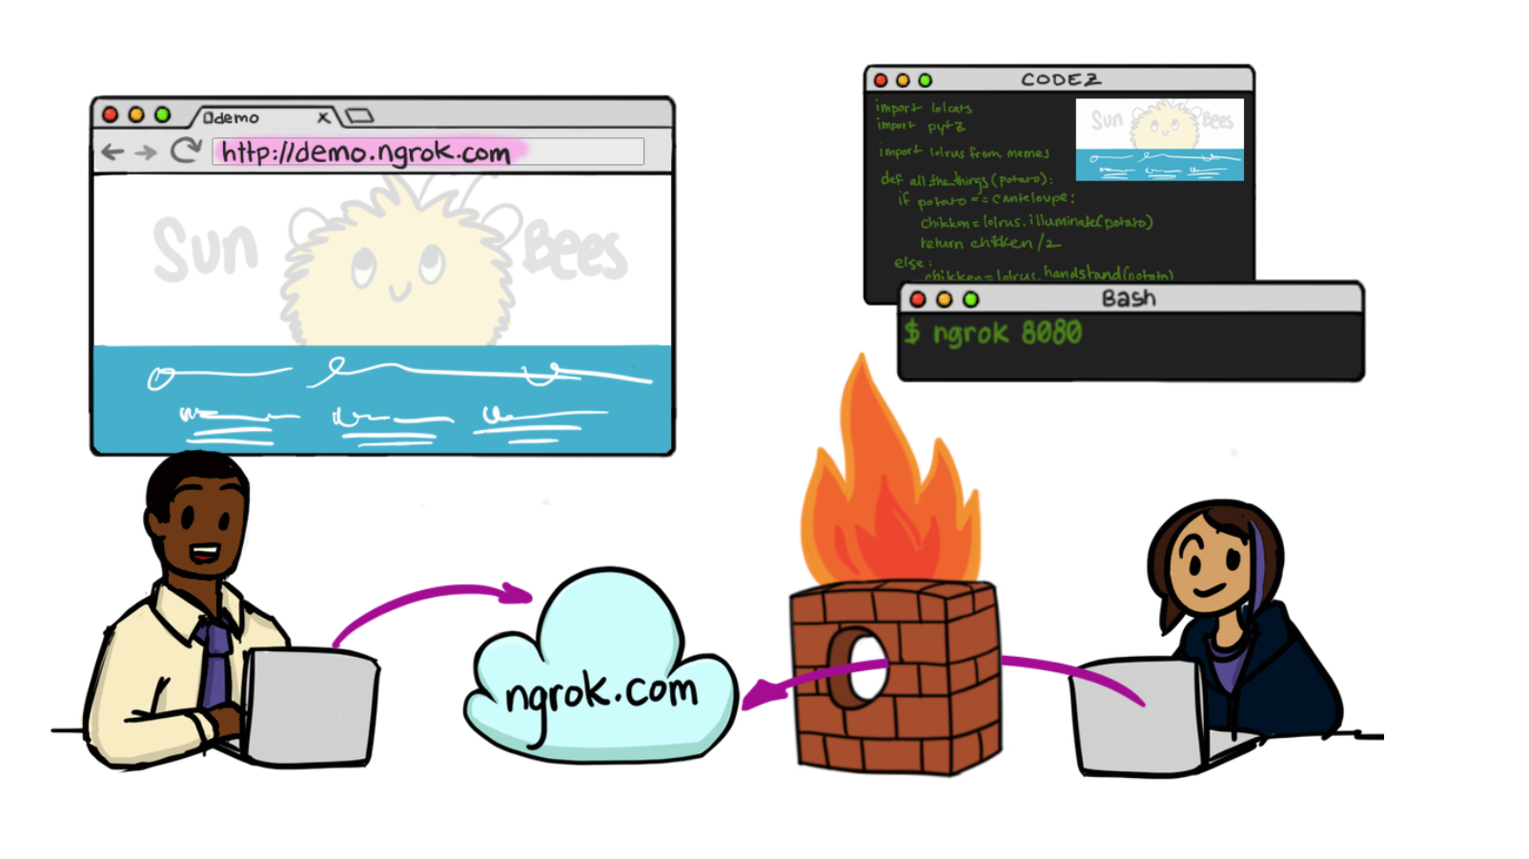

Slide 53
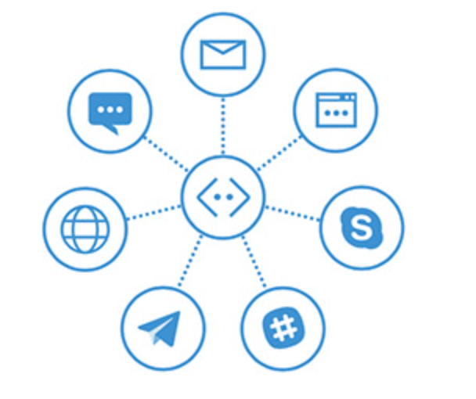
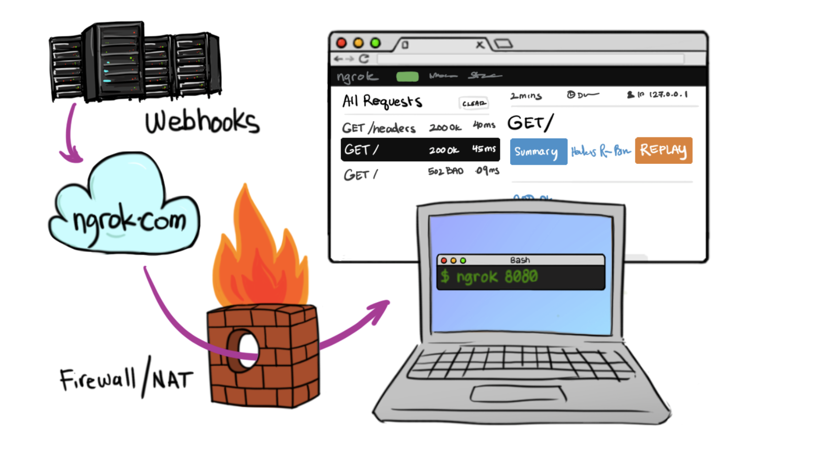
In Cloud
BotFramework

Slide 54
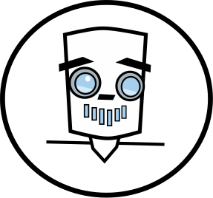
Let’s Get Hands on.

Slide 55
Technology Needed today Node
Installs
Node.js (and npm)
Ngrok
GIT (not necessary but helpful)
VS Code (for node)
Visual Studio 2015 & Bot Template (for C#)
Signups needed
MSID
BotFramework.com
LUIS – Language Understanding Intelligent Services

Slide 56
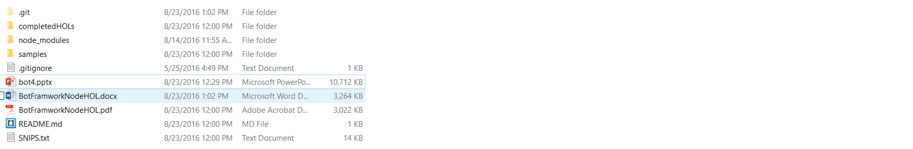
Content
https://github.com/DanielEgan/BotWorkshop
Hands On Labs Document (WORD)
Hands On Labs Document (PDF)
Code snippets for use with PDF

Slide 57
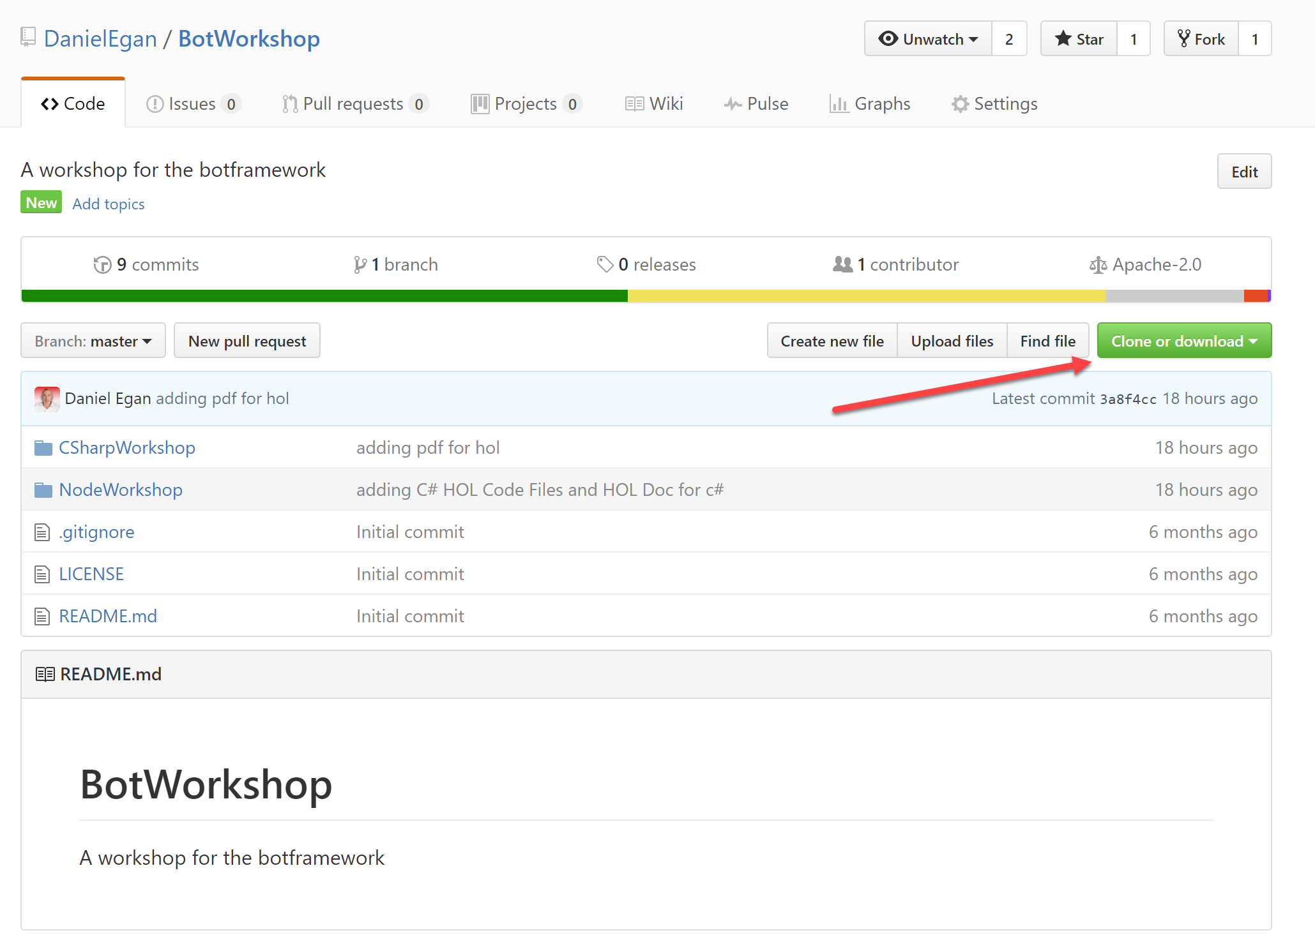
Content
https://github.com/DanielEgan/BotWorkshop

Slide 58
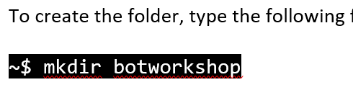
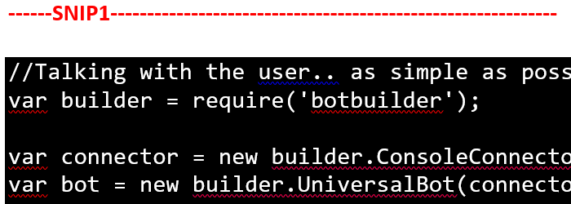
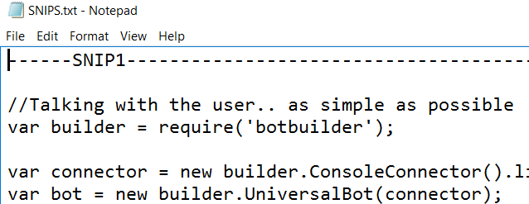
Conventions Used
Don’t type the ~$
If you are using the PDF copy and paste from the txt file NOT the PDF

Slide 59
Additional Materials
https://docs.botframework.com/ - Bot Framework Docs
https://github.com/pveller/ecommerce-chatbot - Node – Implements IIntentInterface
https://github.com/Microsoft/BotBuilder - SDK’s has a samples folder
https://github.com/Microsoft/BotBuilder-Samples - Different Samples (Skype, Facebook, etc.)
https://www.luis.ai/Help - Training videos and HOL for LUIS
https://docs.botframework.com/en-us/tools/bot-framework-emulator/ Emulator download
http://aka.ms/bf-bc-vstemplate C# Bot Template
https://ngrok.com - Ngrok

